Slide 1
An internal-multiple elimination algorithm for all first-order internal multiples for a 1D earth
Yanglei Zou* and Arthur B. Weglein

Slide 2
ISS internal multiple attenuation algorithm
It is the only method that can predict all internal multiples at once with accurate time and approximate amplitude without requiring any subsurface information.
It is model type independent. It is effective for internal multiple removal in acoustic, elastic, absorptive medium et al.
All these huge benefits and advantages make the ISS internal multiple attenuation algorithm standalone and the most capable algorithm today for internal multiple removal.

Slide 3
Why do we need an internal multiple elimination algorithm?

Slide 4
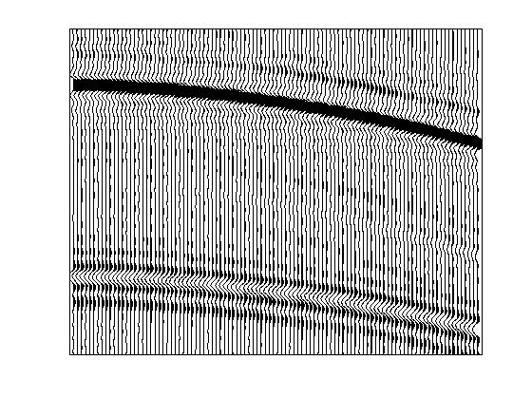
Why do we need an internal multiple elimination algorithm?
1: primaries and internal multiples
are isolated
primary
internal multiple
Solution: ISS Internal-multiple attenuation
+ adaptive subtraction

Slide 5
Why do we need an internal multiple elimination algorithm?
1: primaries and internal multiples
are isolated
primary
internal multiple
Solution: ISS Internal-multiple attenuation
+ adaptive subtraction

Slide 6
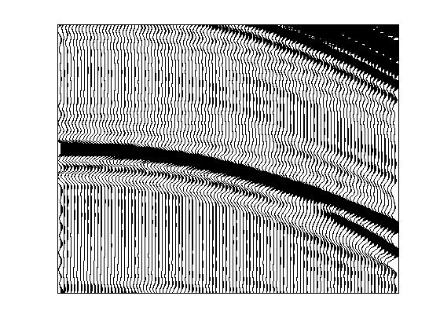
Why do we need an internal multiple elimination algorithm?
1: primaries and internal multiples
are isolated
2: primaries and internal multiples
are proximal or interfering
internal multiple
primary
internal multiple
internal multiple
primary
Solution: ISS Internal-multiple attenuation
+ adaptive subtraction
Solution: Three-pronged strategy
(including internal-multiple elimination)

Slide 7
Why do we need an internal multiple elimination algorithm?
1: primaries and internal multiples
are isolated
2: primaries and internal multiples
are proximal or interfering
internal multiple
primary
internal multiple
internal multiple
primary
Solution: ISS Internal-multiple attenuation
+ adaptive subtraction
Solution: Three-pronged strategy
(including internal-multiple elimination)

Slide 8
A three-pronged strategy to address the challenges
Pre-requisites for on-shore application (Jing Wu, 4:00 PT)
Stronger ISS internal-multiple-removal algorithm
within the algorithm
incorporate dimension of the source (Xinglu Lin, 1:30 PT)
incorporate radiation pattern of the source (Jinlong Yang, 1:55 PT)
beyond the algorithm
spurious events removal (Chao Ma, 2:20 PT)
elimination algorithm
A new adaptive criterion

Slide 9
A three-pronged strategy to address the challenges
Pre-requisites for on-shore application (Jing Wu, 4:00 PT)
Stronger ISS internal-multiple-removal algorithm
within the algorithm
incorporate dimension of the source (Xinglu Lin, 1:30 PT)
incorporate radiation pattern of the source (Jinlong Yang, 1:55 PT)
beyond the algorithm
spurious events removal (Chao Ma, 2:20 PT)
elimination algorithm
A new adaptive criterion

Slide 10
A three-pronged strategy to address the challenges
Pre-requisites for on-shore application (Jing Wu, 4:00 PT)
Stronger ISS internal-multiple-removal algorithm
within the algorithm
incorporate dimension of the source (Xinglu Lin, 1:30 PT)
incorporate radiation pattern of the source (Jinlong Yang, 1:55 PT)
beyond the algorithm
spurious events removal (Chao Ma, 2:20 PT)
elimination algorithm
A new adaptive criterion

Slide 11
A three-pronged strategy to address the challenges
Pre-requisites for on-shore application (Jing Wu, 4:00 PT)
Stronger ISS internal-multiple-removal algorithm
within the algorithm
incorporate dimension of the source (Xinglu Lin, 1:30 PT)
incorporate radiation pattern of the source (Jinlong Yang, 1:55 PT)
beyond the algorithm
spurious events removal (Chao Ma, 2:20 PT)
elimination algorithm
A new adaptive criterion

Slide 12
A three-pronged strategy to address the challenges
Pre-requisites for on-shore application (Jing Wu, 4:00 PT)
Stronger ISS internal-multiple-removal algorithm
within the algorithm
incorporate dimension of the source (Xinglu Lin, 1:30 PT)
incorporate radiation pattern of the source (Jinlong Yang, 1:55 PT)
beyond the algorithm
spurious events removal (Chao Ma, 2:20 PT)
elimination algorithm
A new adaptive criterion

Slide 13
ISS internal multiple elimination
Early ideas
Ramírez(2005)

Slide 14
ISS internal multiple elimination
Early ideas
Ramírez(2005)
Elimination of first order internal multiples generated at the shallowest reflector (1D normal incidence)
Herrera(2012)

Slide 15
ISS internal multiple elimination
Early ideas
Ramírez(2005)
Elimination of first order internal multiples generated at the shallowest reflector (1D normal incidence)
Herrera(2012)
An internal-multiple elimination algorithm
for all first-order internal multiples for a 1D earth
(This presentation)

Slide 16
The structure of this presentation
Why the ISS internal multiple attenuation algorithm predicts approximate amplitude not exactly accurate amplitude?
Extra transmission coefficients (attenuation factor)
From ISS internal multiple attenuation to elimination

Slide 17
The structure of this presentation
Why the ISS internal multiple attenuation algorithm predicts approximate amplitude not exactly accurate amplitude?
Extra transmission coefficients (attenuation factor)
From ISS internal multiple attenuation to elimination

Slide 18
ISS internal multiple attenuation algorithm
(1D normal incidence version)
Notes:
I will show how we get b1 from data later in an example.

Slide 19
ISS internal multiple attenuation algorithm
δ(t-z/c)
reflector 1
R₁
T₀₁
T₁₀
reflector 2
R₂
The reflection data is:

Slide 20
ISS internal multiple attenuation algorithm
δ(t-z/c)
reflector 1
R₁
T₀₁
T₁₀
reflector 2
R₂
The reflection data is:
Make a water speed migration of D(t) :

Slide 21
ISS internal multiple attenuation algorithm
The actual first order internal multiple is:

Slide 22
ISS internal multiple attenuation algorithm
The actual first order internal multiple is:
The ISS attenuation algorithm prediction is:

Slide 23
ISS internal multiple attenuation algorithm
The actual first order internal multiple is:
The ISS attenuation algorithm prediction is:

Slide 24
ISS internal multiple attenuation algorithm
The actual first order internal multiple is:
The ISS attenuation algorithm prediction is:

Slide 25
ISS internal multiple attenuation algorithm
The actual first order internal multiple is:
The ISS attenuation algorithm prediction is:
The time prediction is precise, and the amplitude of the prediction has extra transmission coefficients (attenuation factor) T₀₁T_{10,} which was first discovered and studied in Weglein and Matson (1998)

Slide 26
A generalization of the attenuation factor:
AF_{j} is the attenuation factor for first order internal multiples with a downward reflection at the j^{th} reflector.

Slide 27
internal multiples and free-surface multiples
A free-surface multiple
A internal multiple
Free-surface
A reflector

Slide 28
internal multiples and free-surface multiples
A free-surface multiple
A internal multiple
We know
Free-surface
A reflector

Slide 29
internal multiples and free-surface multiples
A free-surface multiple
A internal multiple
We know
We do not know
Free-surface
A reflector

Slide 30
The structure of this presentation
Why the ISS internal multiple attenuation algorithm predicts approximate amplitude not exactly accurate amplitude?
Extra transmission coefficients (attenuation factor)
From ISS internal multiple attenuation to elimination

Slide 31
For different multiples the attenuation factors are different

Slide 32
For different multiples the attenuation factors are different
V=1500m/s ρ=1.0g/cm³
500m
V=1700m/s ρ=1.8g/cm³
1700m
V=1700m/s ρ=1.0g/cm³
2700m
V=3500m/s ρ=4.0g/cm³
5700m
V=5000m/s ρ=4.0g/cm³

Slide 33
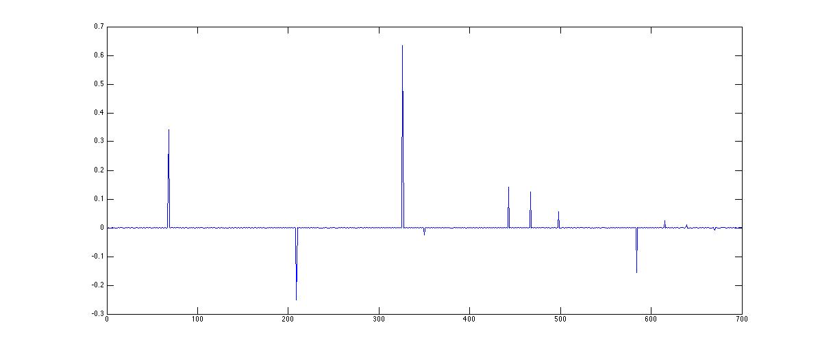
For different multiples the attenuation factors are different
P₃
P₁
M₁
M₂
P₄
P₂

Slide 34
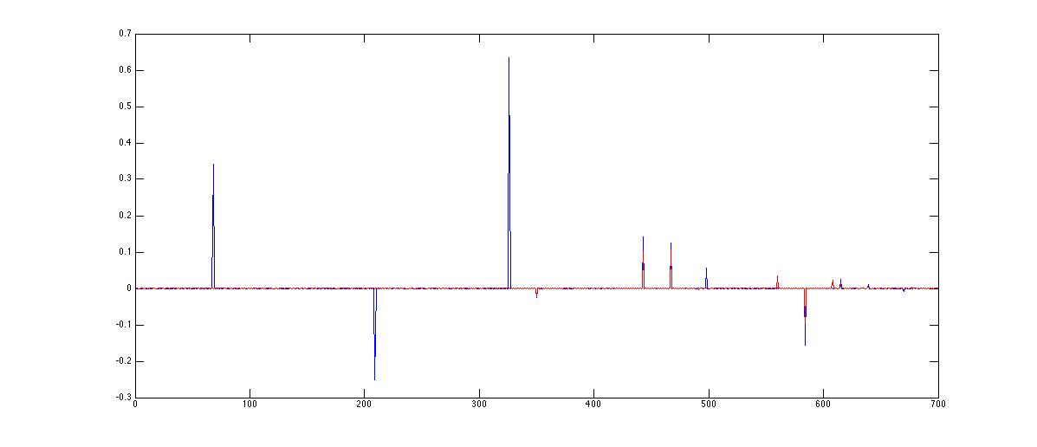
For different multiples the attenuation factors are different
P₃
P₁
M₁
M₂
P₄
P₂

Slide 35
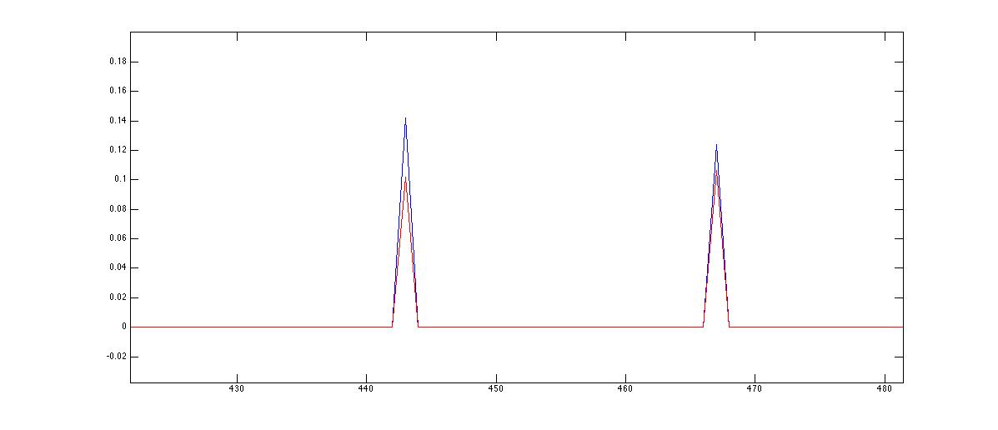
For different multiples the attenuation factors are different
P₃
P₁
M₁
M₂
P₄
P₂
M₁
M₂
AF₂=(T²₁₂T²₂₁)T₁₀T₀₁
AF₁=T₁₀T₀₁

Slide 36
For different multiples the attenuation factors are different
M₁
M₂

Slide 37
The attenuation factors are related to the second integral

Slide 38
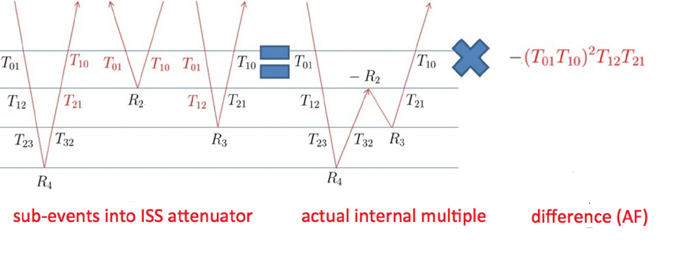
extra transmission coefficients (attenuation factor)
sub-events into ISS attenuator actual internal multiple
attenuation
factor
Extra transmission
coefficients
sub-events into ISS attenuator actual internal multiple
Notes:
It is 1D normal incidence. ………………
The algorithm is fully data driven. Here we show how it works inside the algorithm, we do not separate them in the data.

Slide 39
The structure of this presentation
Why the ISS internal multiple attenuation algorithm predicts approximate amplitude not exactly accurate amplitude?
Extra transmission coefficients (attenuation factor)
From ISS internal multiple attenuation to elimination

Slide 40
ISS internal multiple elimination
ISS internal multiple attenuation
ISS internal multiple elimination

Slide 41
ISS internal multiple elimination
b₁ (data)
F[b₁]
b₁(data)
AF
T
R
Coupled terms
of R and R’
g
b₁(data)

Slide 42
ISS internal multiple elimination
b₁ (data)
F[b₁]
b₁(data)
AF
T
R
Coupled terms
of R and R’
g
b₁(data)

Slide 43
ISS internal multiple elimination
b₁ (data)
F[b₁]
b₁(data)
AF
T
R
Coupled terms
of R and R’
g
b₁(data)
F[b₁]
b₁(data)

Slide 44
Flow chart of the ISS internal multiple elimination algorithm
Input: data
predict internal multiples with correct time and amplitude

Slide 45
Flow chart of the ISS internal multiple elimination algorithm
Input: data
predict internal multiples with correct time and amplitude

Slide 46
Flow chart of the ISS internal multiple elimination algorithm
Input: data
predict internal multiples with correct time and amplitude

Slide 47
Flow chart of the ISS internal multiple elimination algorithm
Input: data
predict internal multiples with correct time and amplitude

Slide 48
Flow chart of the ISS internal multiple elimination algorithm
Input: data
predict internal multiples with correct time and amplitude

Slide 49
Flow chart of the ISS internal multiple elimination algorithm
Input: data
predict internal multiples with correct time and amplitude

Slide 50
Numerical test for elastic PP data in a 1D earth

Slide 51
Internal multiple elimination in an elastic earth
Model
-2500m
12.5m
0
2500m
Z1=0m
Layer 1: ρ=1.0g/cm³, vp=1500m/s, vs=400m/s
Z2=300m
Layer 2: ρ=3.0g/cm³, vp=2000m/s, vs=1200m/s
Z3=800m
Layer 3: ρ=2.1g/cm³, vp=1500m/s, vs=900m/s
Z4=1900m
Layer 4: ρ=1.5g/cm³, vp=1500m/s, vs=1500m/s
Z5=2100m
Layer 5: ρ=1.8g/cm³, vp=2500m/s, vs=1500m/s
Z6=2400m
Yanglei Zou et al. (2014)
Courtesy of Schlumberger De-multiples Team

Slide 52
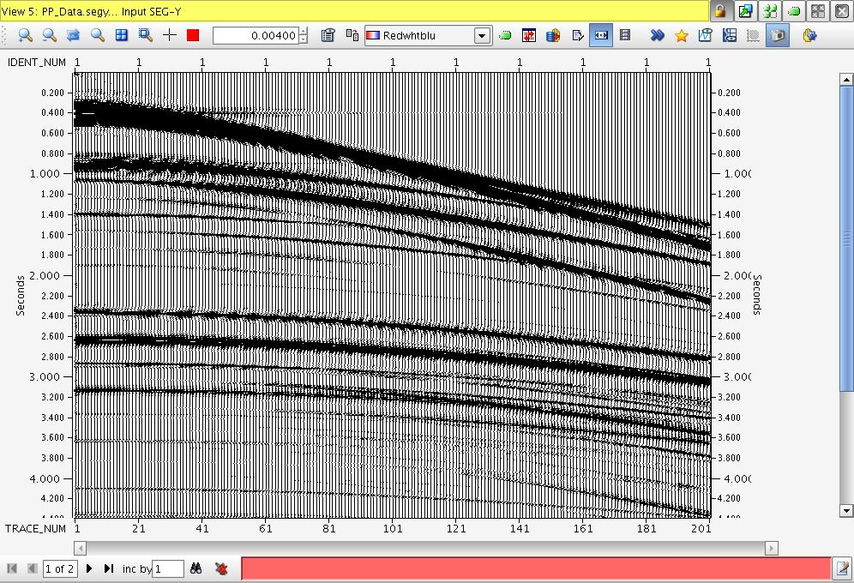
Data
Yanglei Zou et al. (2014)

Slide 53
Data
(with arrows pointed to P primaries)
P primaries
Yanglei Zou et al. (2014)

Slide 54
Data
(with arrows pointed to converted primaries)
Converted primaries
Yanglei Zou et al. (2014)

Slide 55
Data
(with arrows pointed to P multiples)
P multiples
Yanglei Zou et al. (2014)

Slide 56
Data
Yanglei Zou et al. (2014)

Slide 57
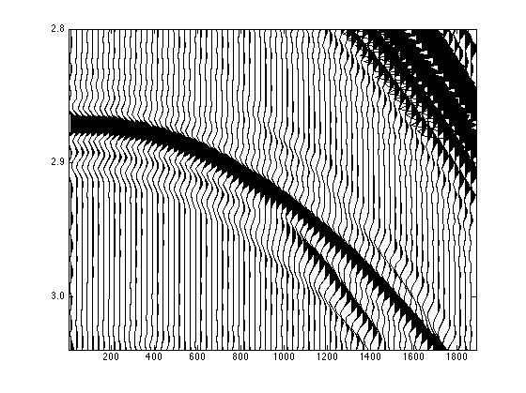
A section of the synthetic data where a primary interferes with two internal multiples

Slide 58
A section of the synthetic data where a primary interferes with two internal multiples
arrow point to a internal multiple
internal multiple

Slide 59
A section of the synthetic data where a primary interferes with two internal multiples
arrow point to another internal multiple
internal multiple

Slide 60
A section of the synthetic data where a primary interferes with two internal multiples
arrow point to a primary
converted wave
primary

Slide 61
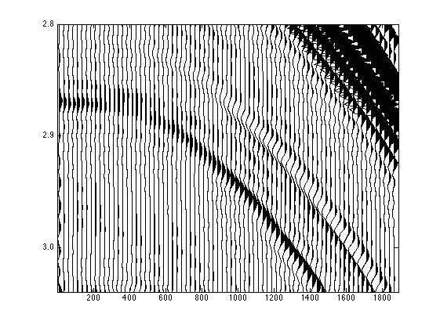
A section of the synthetic data after
internal multiple elimination
converted wave
primary

Slide 62
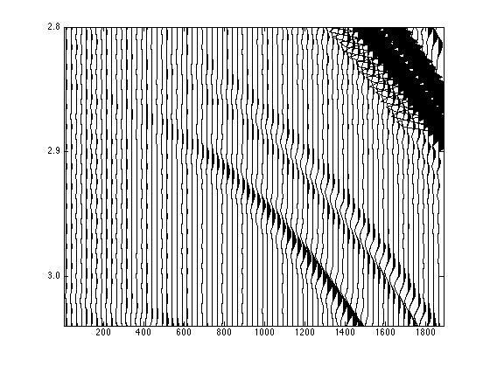
A section of the synthetic data
with only primaries
converted wave
primary

Slide 63
Summary
The ISS free-surface multiple elimination algorithm and ISS internal-multiple attenuation algorithm are the most capable algorithms today for multiples removal. They are the only methods that do not require any subsurface information to remove multiples.
When the primaries and internal multiples are separated, the ISS internal-multiple attenuation algorithm is adequate to remove all internal multiples. When the primaries and internal multiples are proximal or interfering with each other, the ISS internal-multiple attenuation algorithm is less effective and the new elimination algorithm provides a more effective way to remove the multiples.
The new internal multiple elimination algorithm can eliminate all first-order internal multiples for a 1D earth without knowing any subsurface information. The numerical test for a 1D pre-stack elastic PP data shows very encouraging results.
We are developing an elimination algorithm for 2D and 3D earth by identifying terms in the inverse scattering series.

